Slide 1
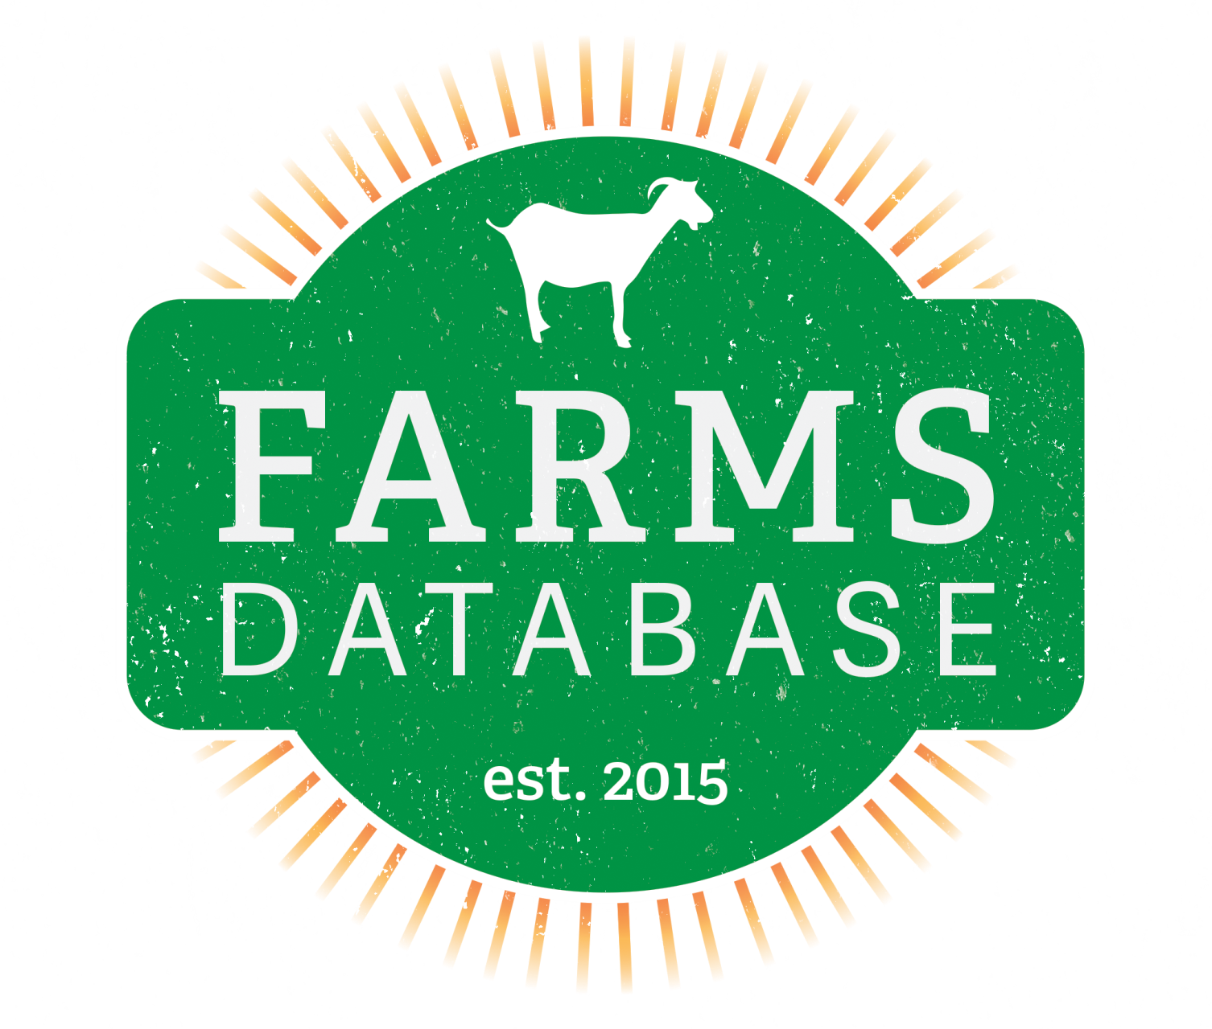
Michael Jones Andrew Taylor Mack Bartus
Michael Pace Kara Born

Slide 2
System Metaphor
As an all inclusive livestock management tool, FARMSdatabase provides users a means to maintain records of all of their animals, generate graphs and spreadsheets of their data over time, compare their data to other farms, and keep up-to-date contact lists of all they do business with.

Slide 3
Cycle Intent
Users will be able to generate a graphical summary, which includes the statistics of the sitewide average, to view and compare their herd data. Users and admins will be able to export their herd summary to excel. The
user will be able to view average daily weight gain on a new offspring performance page.

Slide 4
User Stories
✓ User can view average daily gain (ADG) in Offspring
Performance
✓ User can generate a graphical summary to view and
compare his herd
✓ Admin can generate a summary of all users
✓ Admin can create and edit FAQs
✓ Admin can view and delete inactive user accounts
✓ User can export his herd data summary to Microsoft Excel
✓ User can add health scores to each animal in his herd
... User can upgrade from trial to member account via Paypal

Slide 5
Website Design Decisions
+ Difficult to view progress of children weights
- Created “Offspring Performance” page
+ Decided to add FAQ and License agreement
- Admin can easily edit
+ Malicious/Inactive Users
- Added page to view all users
- Shows “member since”
- Can Delete
+ Graphs looked repetitive and boring
+ Export to excel
- In case user leaves website

Slide 6
Technical Difficulties
+ UI/UX testing requires a lot of manual testing
+ Easy to add values to DB with scripting
+ Must account for each potential scenario
+ Reuse code, but difficult to validate
+ Dividing by zero, null values, etc
+ Issues publishing to website
+ Had to remove unused packages (Microsoft.OWIN)
+ Other/Non-technical - Paypal integration

Slide 7
*Process Discussion
Project organized on Google Drive
Kept meeting minutes, cycle documentation, product backlog
How our backlog works
All tasks are broken down by difficulty
Task highlighting who does what
Weekly group meetings
Google hangout chat for immediate problems/resolutions

Slide 8
Lessons Learned
You can never test enough - test each feature before publishing
Set up automatic backups for DB
MSSQL does not have automatic backups
Importance of peer review
Allow cowboy coding if there is good documentation/comments
Keep end goal in mind
Develop features once to prevent maintenance
Goat gestation, realistic weaning/post weights and dates, etc.

Slide 9
Future Development
Add support for Sheep and other animals
Implement PayPal integration
* Allow users to upgrade account from trial to member
Allow record keeping for milk and wool products
Support different breed lists depending on user’s country
Multiple language support
Dynamic columns, custom graphs

